Slide 1

Quantum Sensing for the weather
Project Number: 24-1-1-3121.
Student names: Mohammad Shalabi.
Mentor name: Khen Cohen
Project location: Tel Aviv University.
Mentor signature:

Slide 2
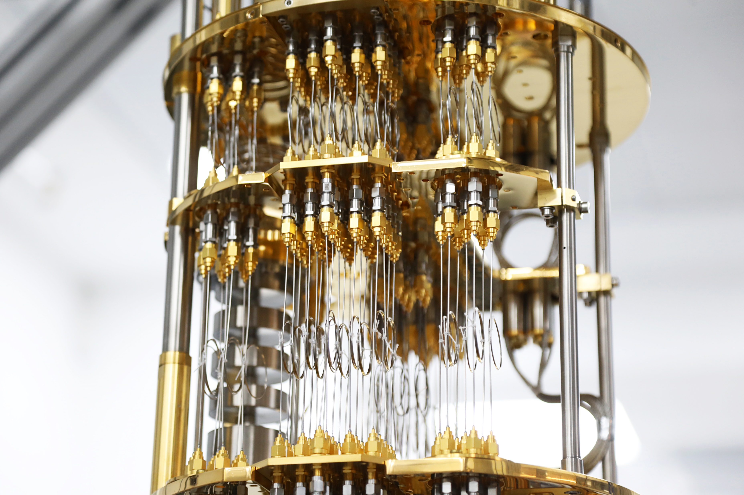
Motivation & Background
Classical Sensing (e.g. Commercial Microwave Links): - Cost-effective but imprecise
- Measures signal attenuation, limited sensitivity
Quantum Advantage:
- Extreme sensitivity to environmental noise
- Can reveal phase distortions and subtle turbulence effects
Goal: Use quantum graph states as passive sensors in noisy free-space channels

Slide 3
Research Objective
Key goals:
Study quantum state degradation due to rain, dust, turbulence, and clear weather
Measure changes in fidelity, entanglement, mutual information, and sensitivity
Identify which graph topologies are best for:
Quantum sensing (sensitive to noise)
Quantum communication (resilient to noise)

Slide 4
Project Evolution
Started with Pauli noise toy models on small graph states
Discovered even a single error (N = 1) meaningfully affects entanglement
Scaled up to weather-inspired noise:
Modeled noise with Poisson (rain), Weibull (dust), Log-normal (turbulence)
Built a Monte Carlo simulation framework for topological analysis

Slide 5
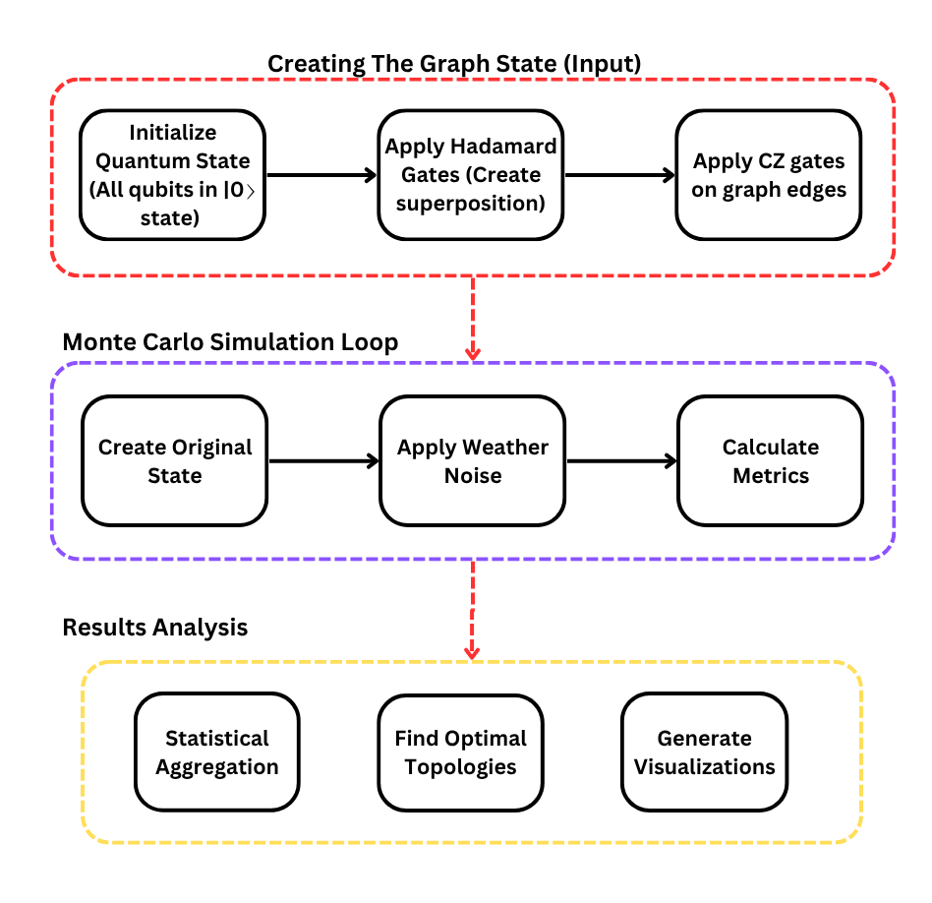
Simulation Environment
Developed in Python with:
Graph Generator (15 topologies including complete, ring, line, star…)
Weather Noise Engine (samples errors from weather-based distributions)
Monte Carlo Simulator (100 trials/config)
Metrics calculated:
Fidelity
Frobenius distance
Mutual information
Entanglement change
Sensitivity
Resilience

Slide 6
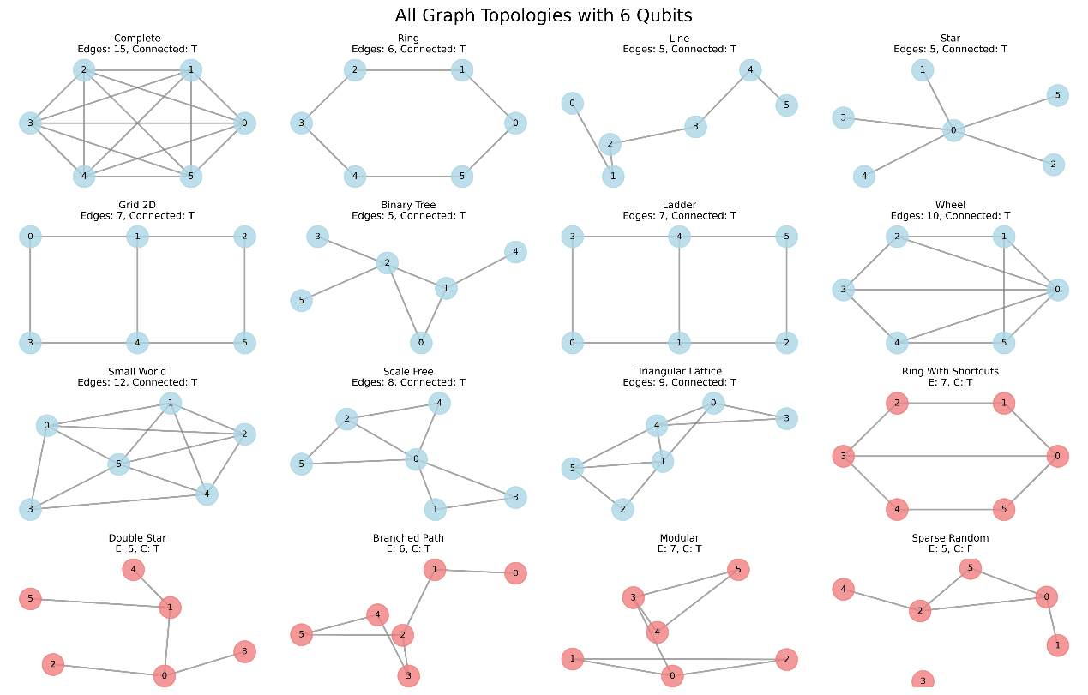
Simulation Scope
Topologies tested: 15 (standard + custom)
Qubit counts: 3–8
Weather models: Rain, Dust, Turbulence, Clear
Noise intensities: 0.2 to 1.5 (6 steps)
Trials per config: 100
Total simulations: tens of thousands of data points

Slide 7
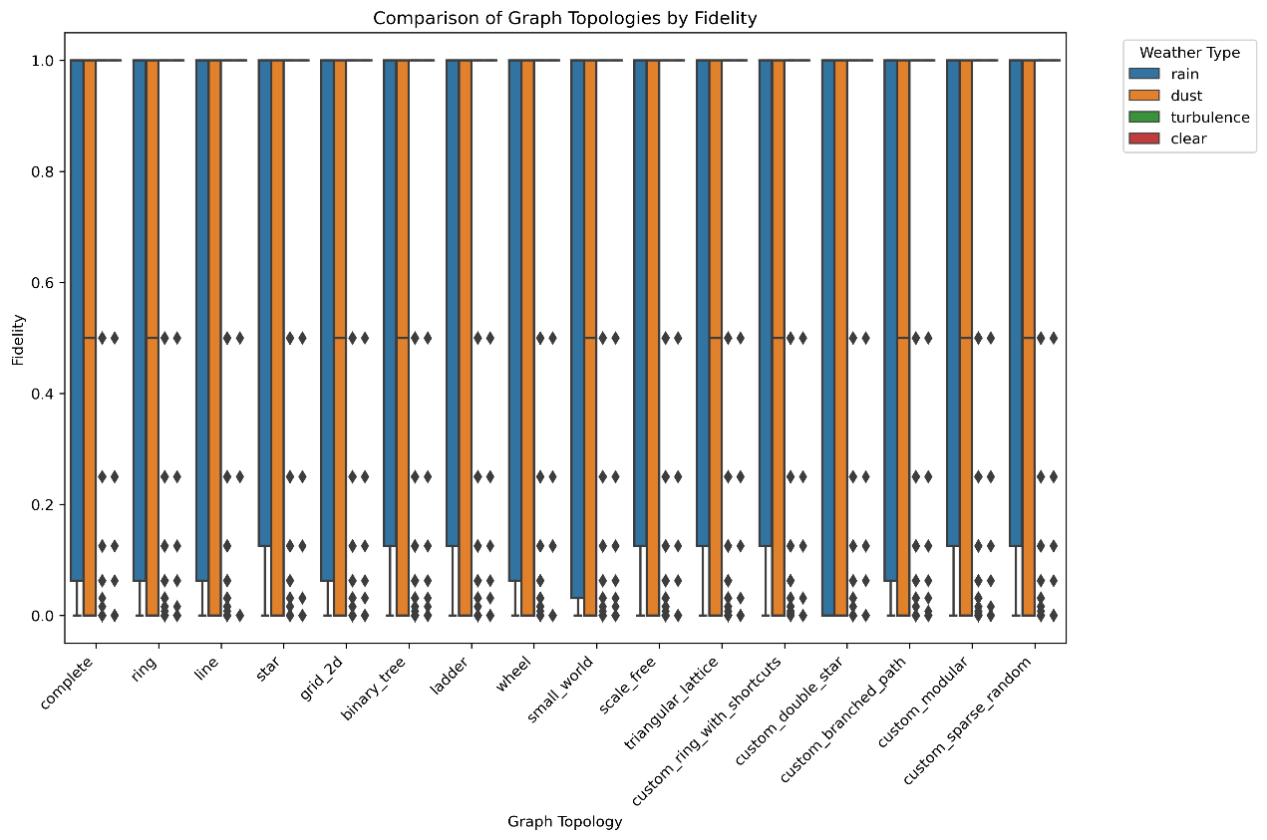
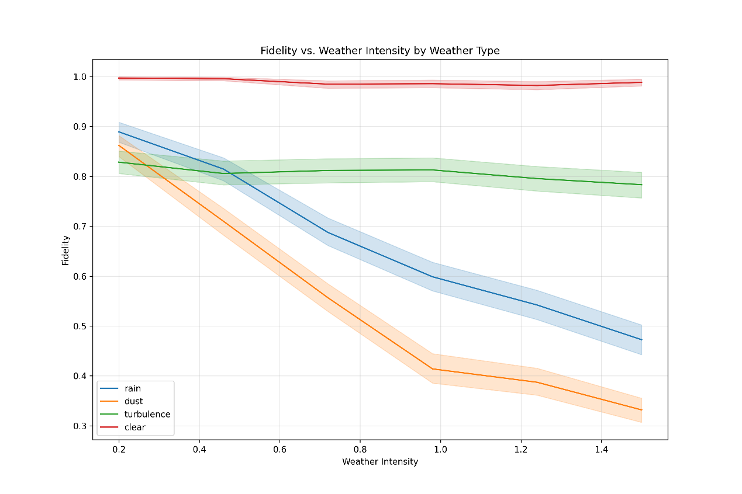
Fidelity Results
Fidelity degrades with intensity
Dust and Rain cause the greatest fidelity loss
Turbulence and Clear show high stability
Topology does not significantly affect fidelity
Fidelity vs. Weather Intensity by Weather Type
Comparison of Graph Topologies by Fidelity

Slide 8
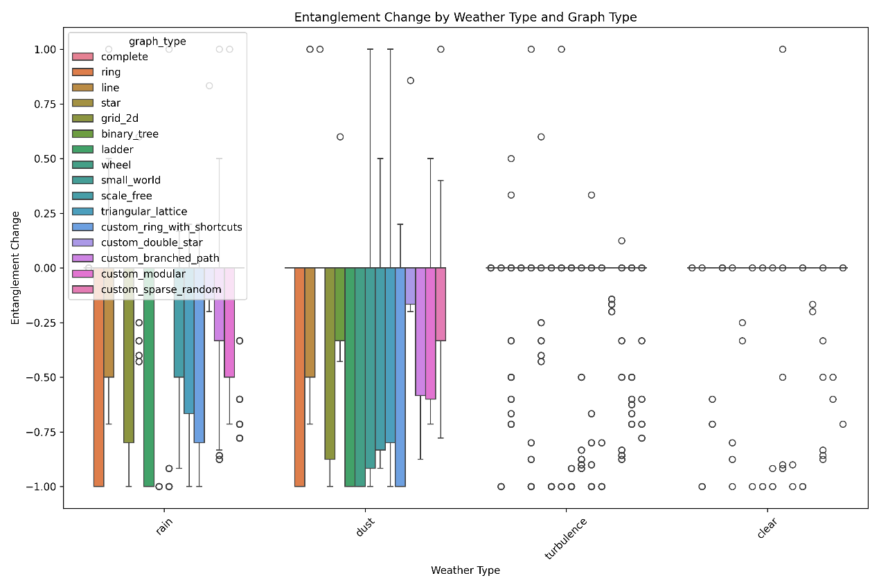
Mutual Information & Entanglement
Mutual information drops fastest in larger graphs and under Dust/Rain
Entanglement change is significant for rain and dust, minimal for clear/turbulence
Graph structure affects entanglement preservation
Entanglement Change by Weather Type and Graph Type

Slide 9
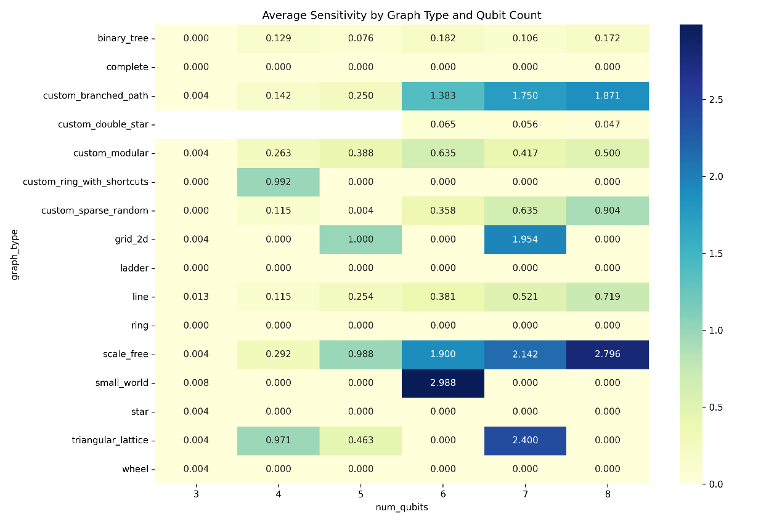
Sensitivity – A Key Sensing Metric
Sensitivity is the relative entanglement loss due to noise
Highly topology-dependent:
High: Scale-Free, Custom Branched Path
Medium: Line, Modular
Low: Complete, Ring, Star
Sensitivity increases with qubit count
Average Sensitivity by Graph Type and Qubit Count

Slide 10
Evaluation of Project Requirements
Requirement | Goal | Achieved? | Comment
Concurrence Sensitivity | 80% consistency in trends | ✔️ Yes | Achieved via entanglement change and sensitivity metrics. Clear patterns.
Frobenius–Fidelity Correlation | ≥85% correlation | ⚠️ Partial | Frobenius similarity not included in final results. Fidelity trends strong.
Weather Classification | ≥75% classification accuracy | ❌ No | Not implemented. Future work direction.

Slide 11
Evaluation of Project Deliverables
Deliverable | Achieved? | Comment
Characterize entanglement degradation | ✔️ Yes | Done using fidelity, mutual info, entanglement change, and sensitivity.
Analyze noise effects at fixed parameters | ✔️ Yes | Simulations varied weather intensity while holding other variables fixed.
Expectation-based metrics and statistical trends | ✔️ Yes | Metrics like mutual information and entanglement tracked across trials.
Results analysis and design conclusions | ✔️ Yes | Clear trade-offs observed; strong summary insights.
Simulate weather-based quantum noise | ✔️ Yes | Core contribution of the project. Executed for four weather models.
Experimental setup | ⚠️ Partial | Not built, but discussed in final report as future work.

Slide 12
Conclusions
Weather dominates fidelity degradation; topology has minimal effect
Topology dominates sensitivity; some structures amplify entanglement loss
Clear and turbulent weather allow for robust communication
Trade-off exists: cannot optimize for both sensing and stability
Graph-based quantum sensing shows strong promise

Slide 13
Future Work
Design a real-world experiment to test simulation predictions
Investigate Local Clifford transformations
Explore additional sensing metrics (Like QFI)

